Slide 1
Employee Turn Over Analysis
Deepak Chawde

Slide 2
Problem Statement : Manager want to know How to reduce employee turn over. Goal : HR want to know the employee retention. Task : Analysis the hypothesis and data story on reason for churn Data : 15000 employee data Link : Click Here

Slide 3
Questions from Management: what is the main cause of turnover Is there is something surprise in data? What segment should we focus on? Which depetment has highest turnover? Do we need to increase X or decrease X? Where should we put our pilot program?

Slide 4
Insight Development
What is the goal of business?
Make money/ reduce employee churn/ limit recruitment cost
What is the matrix of success and failure?
Employee retention and churn
What is the trend?
Department with high and low churn
What influence our matrix and trend?
Other matrix affect on churn
How to fix the trend?
increase x

Slide 5
Tools and technique
Tools: Excel , PowerPoint
Technique : Pivot Table, Power Query , Dax
Statistics : Mean , mode, Medain

Slide 6
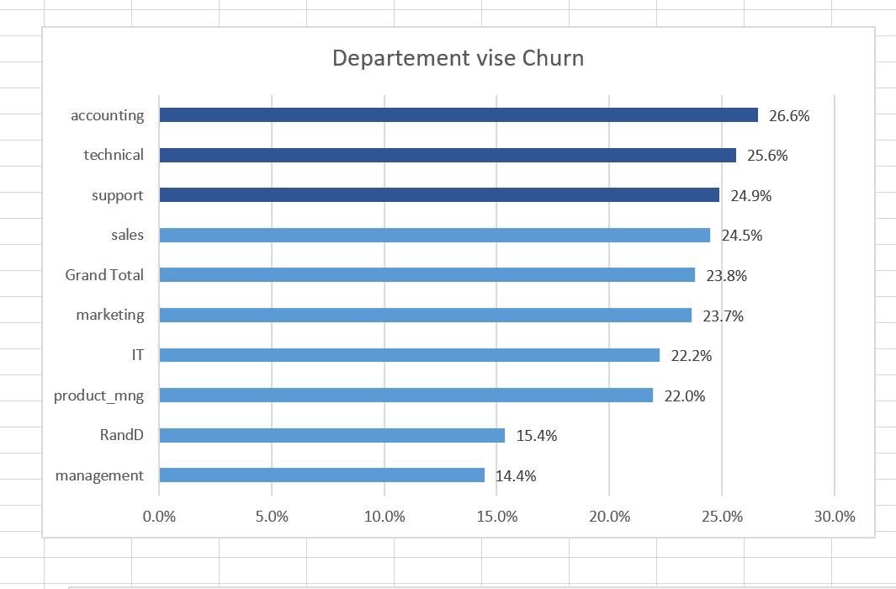

Slide 7
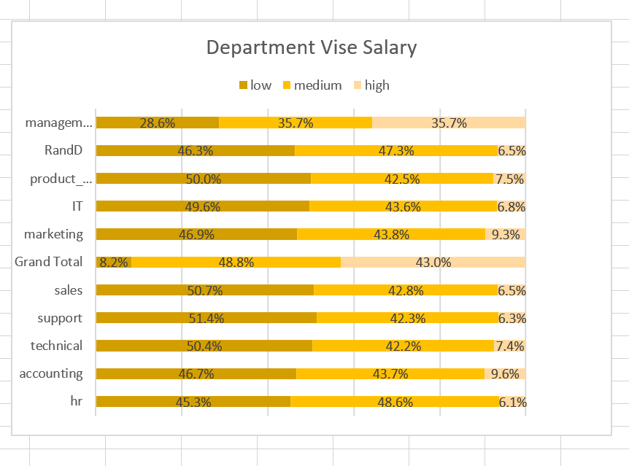
High and low churn:
The employees with the most churn also have the most employee in the low salary.
Salary :
Although salary are lower for the top 3 department with low retention. Not all the department has low salary.

Slide 8
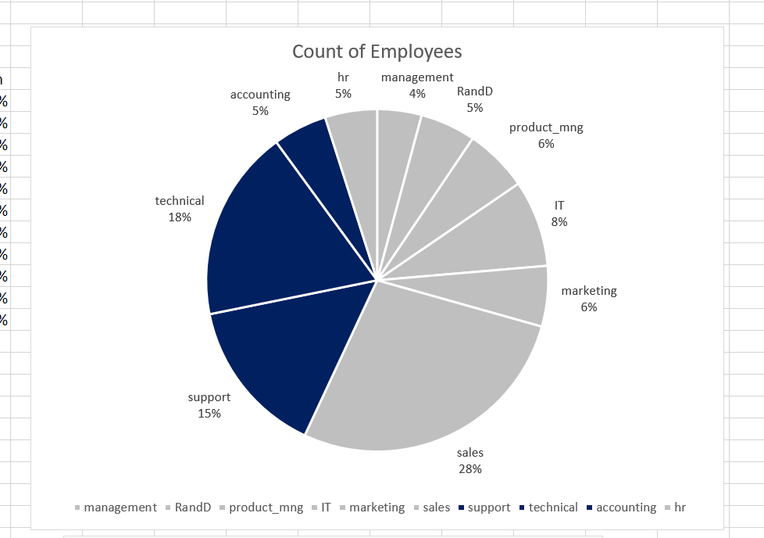
Top 3 department with churn and employees:
Although these department have the most churn there don necessary equal large volume of employees.

Slide 9
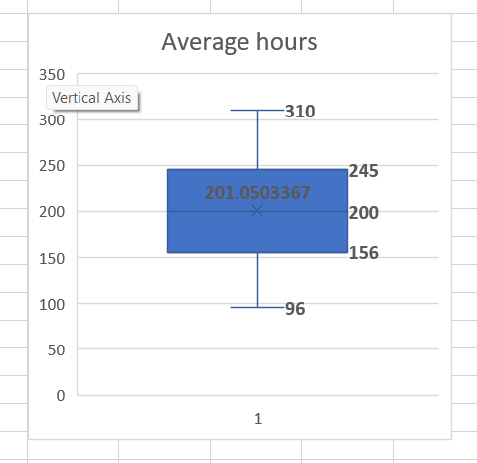

Slide 10
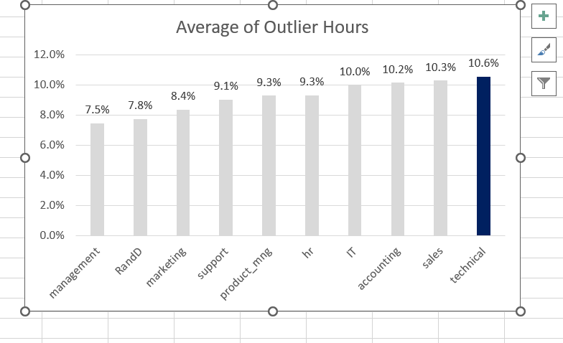
Top 3 department by churn and long hours:
When evaluate the long hours outliers which would be at the 90th percentiles. It’s easy to determine that the technical department has highest amount of employee in this segment.

Slide 11
Thank You

